Slide 1

EcoFinds – Empowering Sustainable Consumption
Revolutionizing Second-Hand Marketplaces for a Greener Future

Slide 2

THE CHALLENGE WE FACE
The Mounting Waste Crisis
Our modern consumer habits have led to an unprecedented increase in waste, straining natural resources and polluting our planet. Despite a growing desire for sustainable alternatives, consumers often struggle to find reliable and convenient platforms for buying and selling second-hand goods.
Growing Consumer Waste
Linear consumption models lead to excessive production and rapid disposal, filling landfills and depleting resources.
Lack of Trusted Platforms
Many existing second-hand markets lack robust verification, secure transactions, and user-friendly interfaces, deterring adoption.

Slide 3

OUR AMBITION
EcoFinds: Vision & Mission
EcoFinds is more than just a marketplace; it's a movement towards conscious consumption. Our platform is designed to make sustainable choices accessible and appealing to everyone.
Vision
Mission
To become the premier destination for conscious consumption, where unique finds meet sustainable choices, fostering a circular economy.
To build an intuitive and trustworthy cross-platform application (desktop and mobile) that simplifies the buying and selling of second-hand goods, promoting reuse and reducing environmental impact.

Slide 4
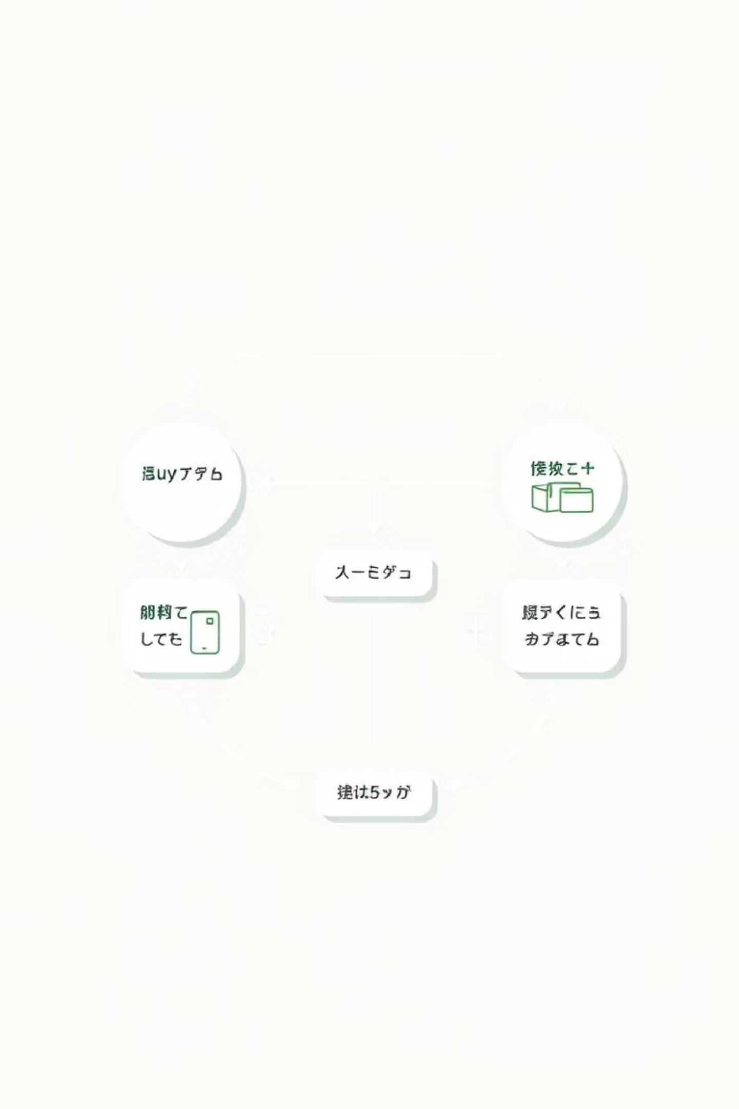
HACKATHON FOCUS
Problem Statement & Prototype Scope
For this hackathon, we focused on building a foundational prototype addressing critical user needs in a second-hand marketplace. Our core objective was to demonstrate the viability and user-friendliness of EcoFinds through key functionalities.
01
User Authentication
Secure sign-up and login capabilities for new and returning users.
02
Product Listing
Empowering sellers to easily post items with descriptions and photos.
03
Browsing & Search
Intuitive tools for buyers to discover items by category or keywords.
04
Shopping Cart
Enabling buyers to manage potential purchases before checkout.

Slide 5






FOUNDATIONAL CAPABILITIES
Core Features of EcoFinds
Our prototype demonstrates a robust set of features essential for any functional marketplace, designed with user experience and sustainability in mind.
User Authentication & Profile
Product Listings (CRUD)
Secure registration, login, and personalized user dashboards.
Create, Read, Update, Delete functionality for item listings.
Browsing & Search
Cart & Previous Purchases
Efficient search, category filters, and intuitive product discovery.
Manage items for purchase and review past transactions.
Dashboard
Product Detail View
Centralized hub for managing listings, profile, and interactions.
Comprehensive information and images for each item.

Slide 6






USER EXPERIENCE
EcoFinds User Flow
We've designed a clear and intuitive path for both buyers and sellers, ensuring a seamless experience from browsing to transaction.
Sign Up / Log In
Quick and secure access to the platform.
Create Profile
Personalize user identity and preferences.
Browse & Search
Discover items through categories, keywords, or filters.
Manage Listings / Add Product
Sellers easily manage their items, buyers view details.
Add to Cart & Checkout
Streamlined purchase process for buyers.
Previous Purchases
Review transaction history and manage orders.

Slide 7
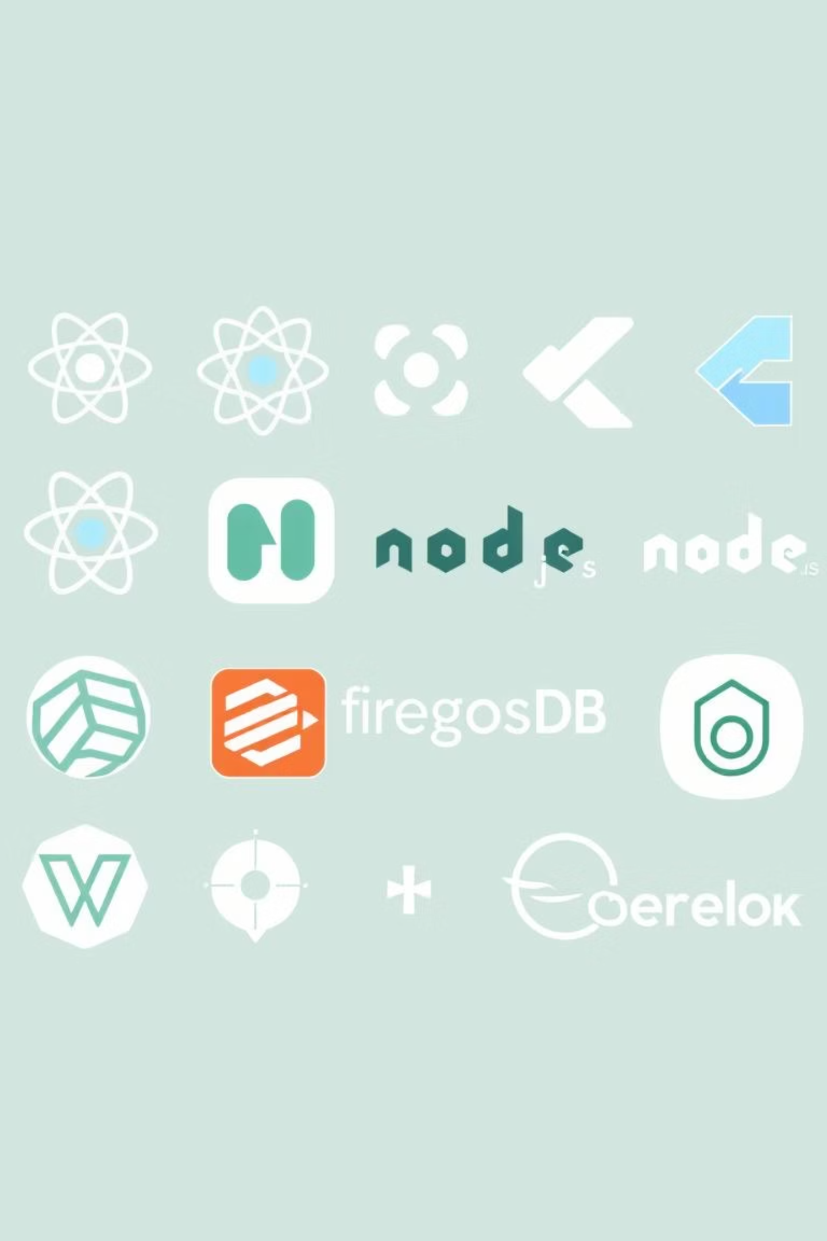
TECHNOLOGY BEHIND ECOFINDS
Our Robust Tech Stack
EcoFinds is built on a modern, scalable, and efficient technology stack, ensuring a smooth and responsive experience across all devices.
Frontend & Cross-Platform
Authentication & Deployment
React.js: For dynamic and responsive web interfaces.
JWT / Firebase Auth: Secure user authentication and authorization.
Flutter: Enabling seamless cross-platform mobile development.
Vercel / Heroku: Reliable and efficient hosting for rapid deployment.
Backend & Database
Node.js / Express: Powering our scalable server-side logic.
MongoDB / Firebase: Flexible and efficient database solutions for diverse data.

Slide 8
OUR DATA APPROACH
Efficient Data Structures & Management
To ensure optimal performance and user experience, we've implemented efficient data structures that facilitate quick lookups, categorization, and tracking of marketplace activities.
Users
Hash maps for rapid retrieval of user profiles and authentication details.
Products
Category trees for hierarchical classification and keyword indexing for efficient search and filtering.
Cart & Purchases
Linked records and arrays to manage current shopping cart items and historical purchase data.

Slide 9
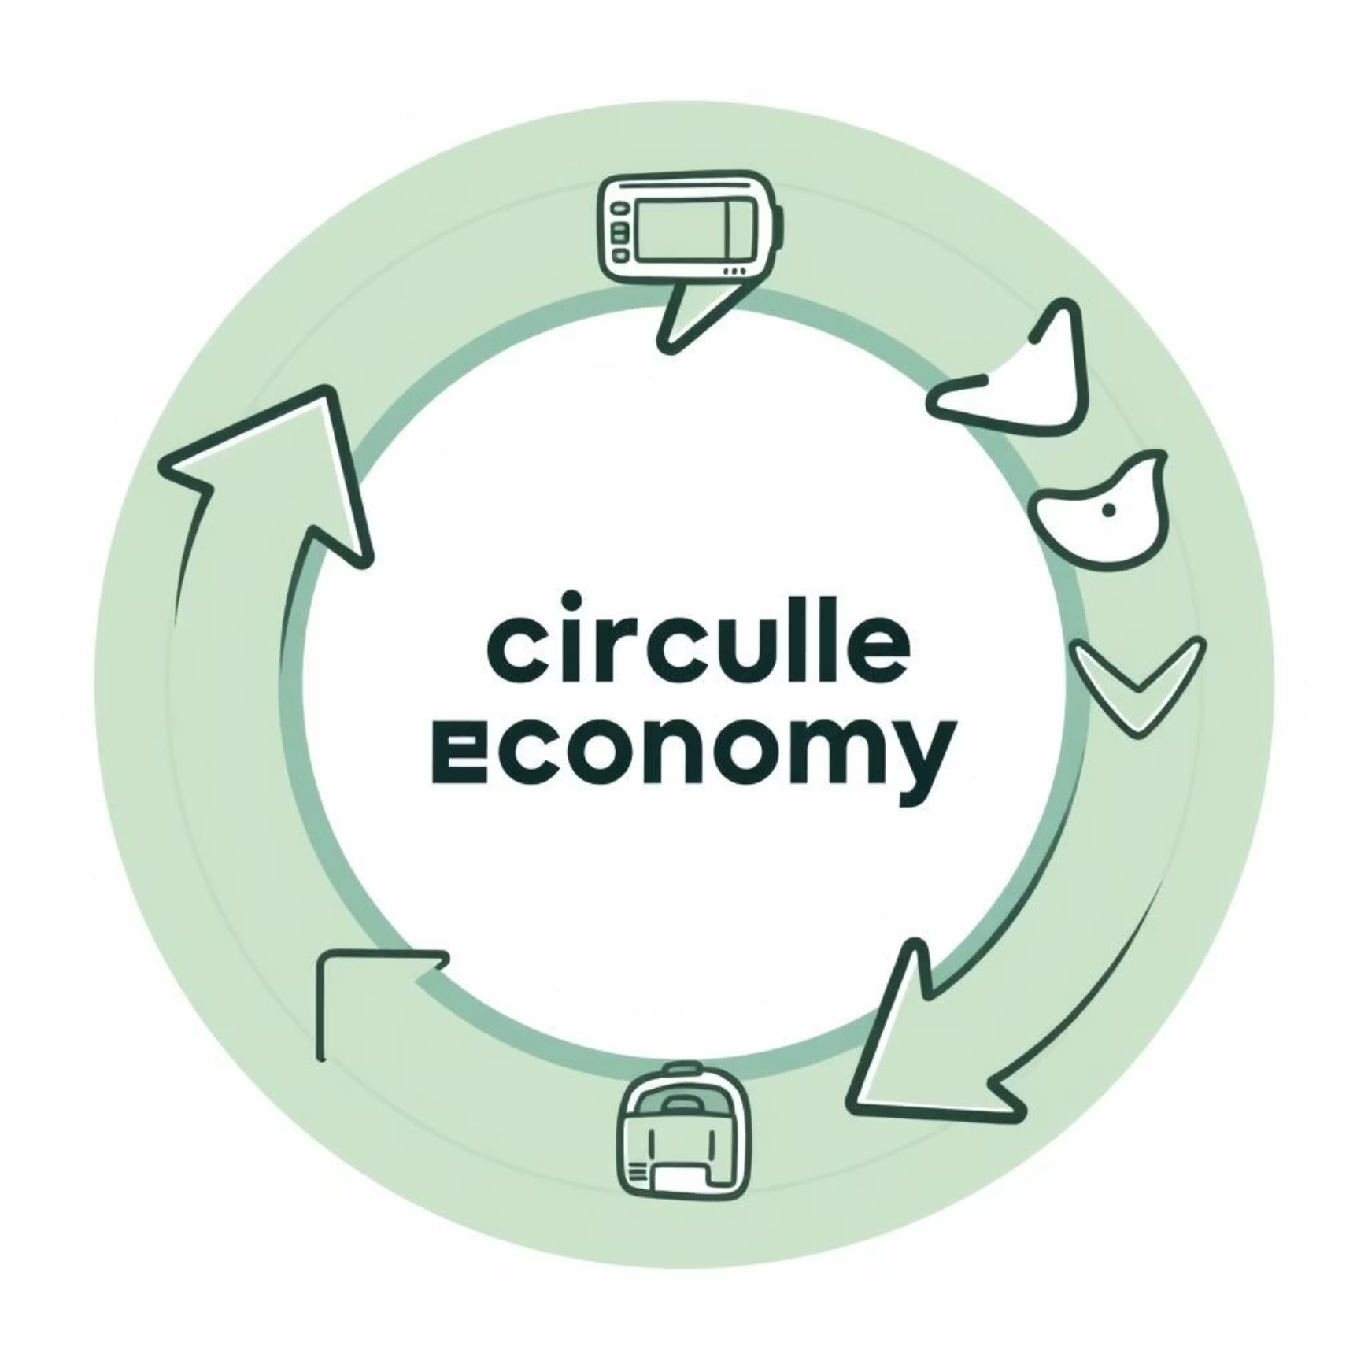
LONG-TERM VISION
Impact & Future Enhancements
EcoFinds is designed to make a tangible impact on sustainability while providing a valuable service. Our roadmap includes exciting features to further enhance user experience and community engagement.
Sustainable Impact
Reduces Waste: Promotes reuse and extends product lifecycles.
Affordable Choices: Provides cost-effective options for buyers.
Community Building: Fosters a trusted community of conscious consumers.
Future Features
AI-powered recommendations for personalized finds.
Integrated payment gateways and delivery tracking.
Comprehensive ratings and reviews for enhanced trust.
Gamification elements to reward sustainable choices.
Thank you for your time. Questions?

